Slide 1
DAT Class 13
Cross Validation, Model Prep

Slide 2
Categorical Encoding
Cross Validation, Model Prep

Slide 3
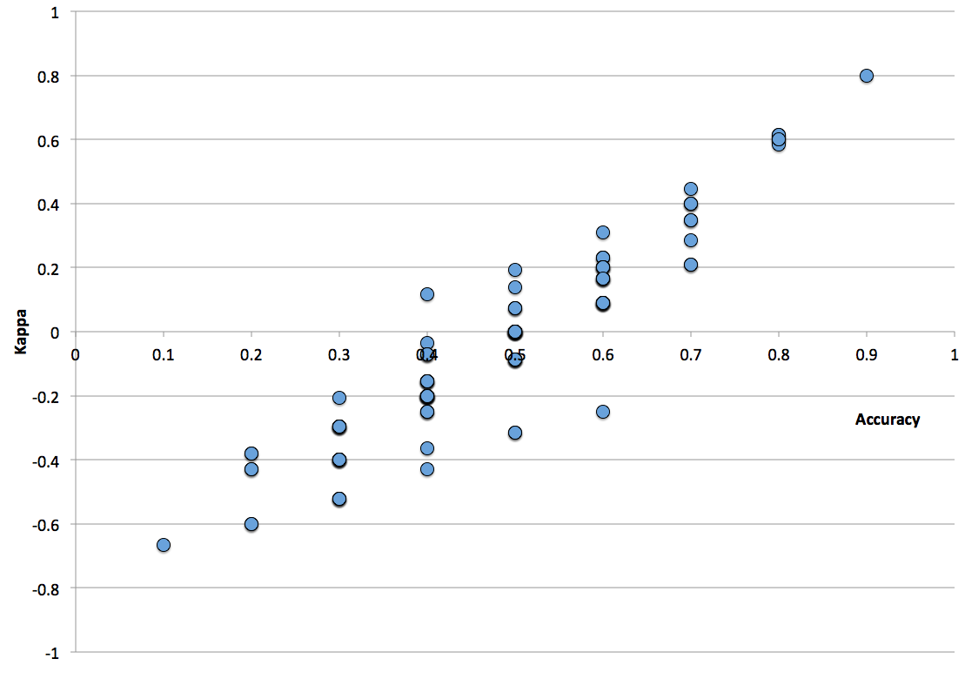
Categorical Columns
What About Columns That Have A Lot of Unique Values?
Common issue
  Too many columns can blow up your model!
These are often some of your most important columns!
  Zip code, medical billing codes, non-repeating text, etc
General Strategies:
  Reduce to a lower dimension
  Target Encoding
Notes:
This is where you go and introduce the training and test split. Go through the shapes of the returned values, make sure everyone is clear on what’s happening.
For

Slide 4
Categorical Columns
High Cardinality Columns, Cont:
Common practices:
Create ‘Other’ Value for low frequency values
Group based on average value for target variable
Notes:
This is where you go and introduce the training and test split. Go through the shapes of the returned values, make sure everyone is clear on what’s happening.
For

Slide 5
Regularization
Machine Learning With Python

Slide 6
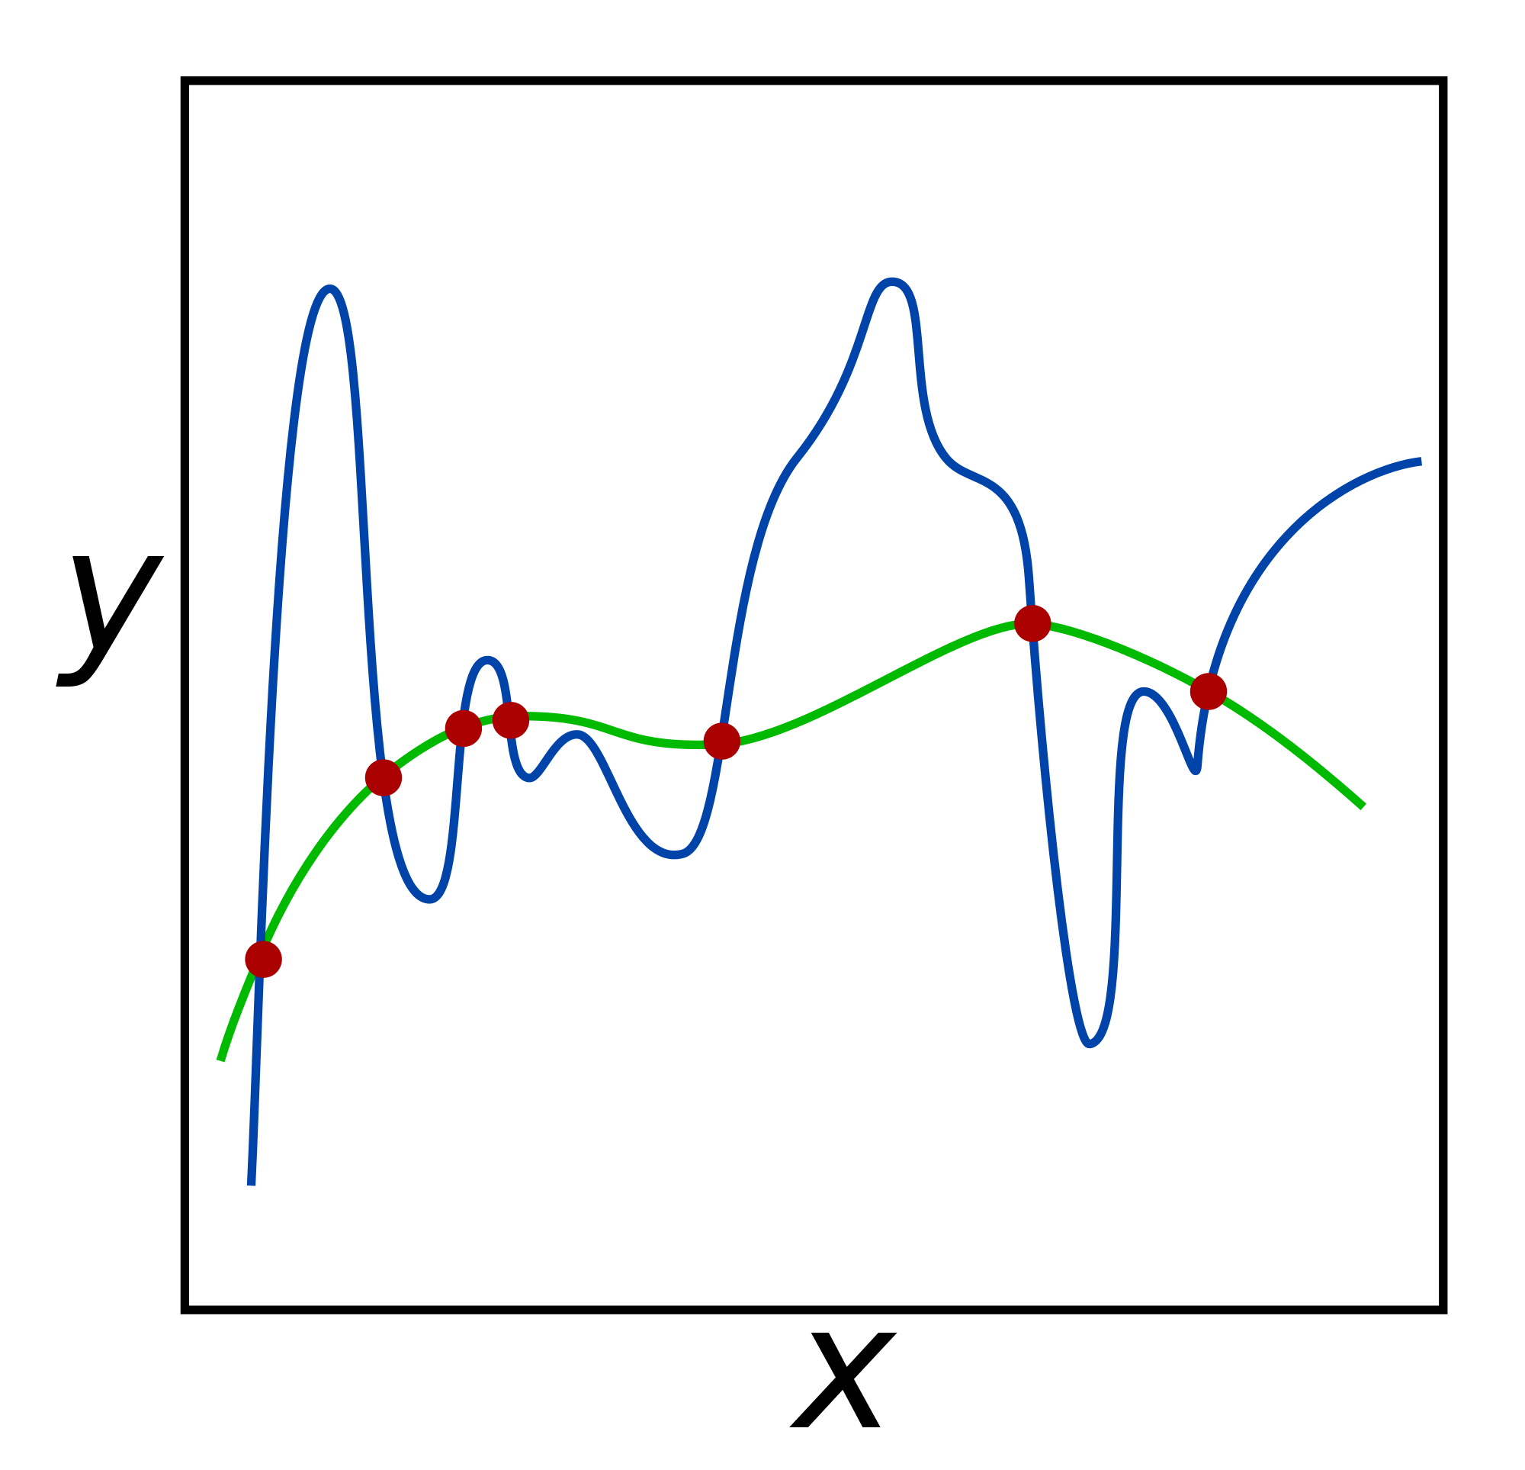
Regularization
Commonly used technique to curb overfitting in your models.
Does so by deliberately injecting a measured amount of bias into your model
You call bias injection a ‘penalty’
Result is that it shrinks your weights
Also known as ‘weight’ decay
Used in most algorithms that use gradient descent for optimization
Notes:
This is where you go and introduce the training and test split. Go through the shapes of the returned values, make sure everyone is clear on what’s happening.
For

Slide 7
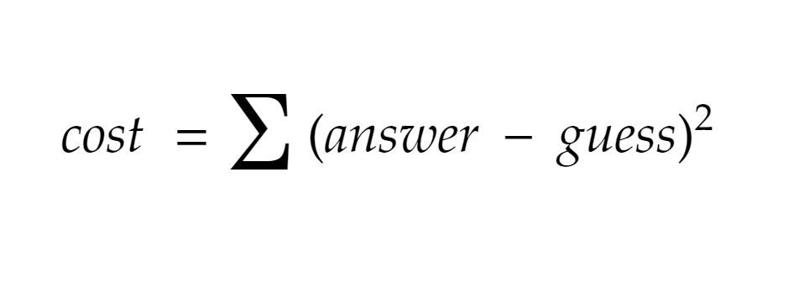

Slide 8
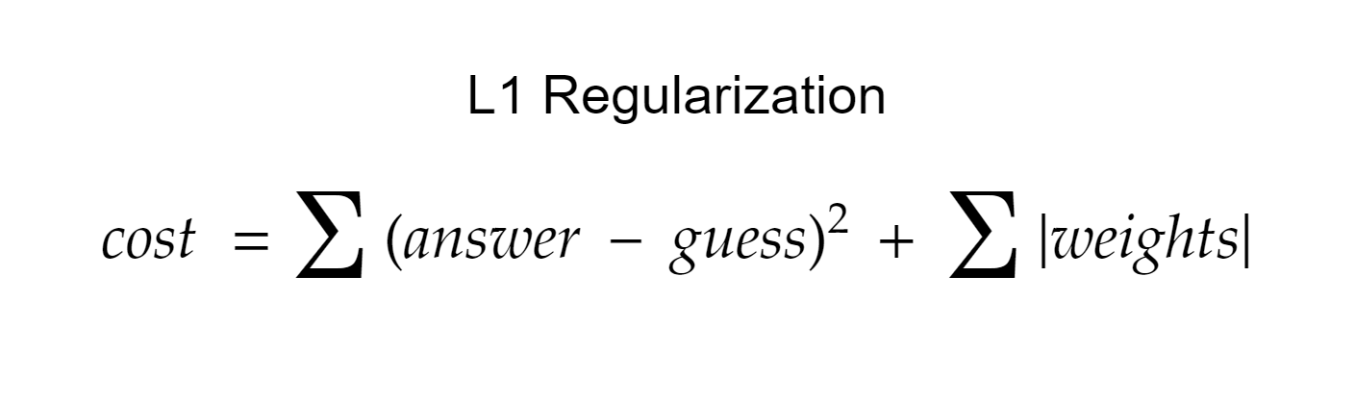

Slide 9
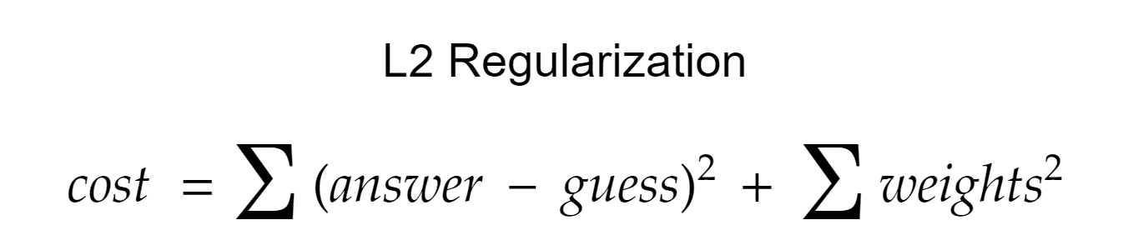

Slide 10
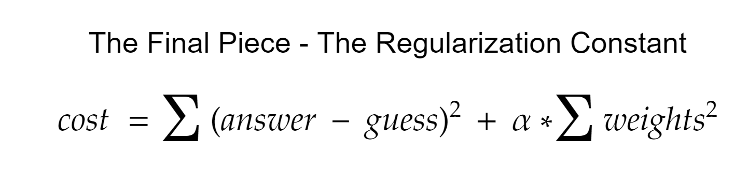
Notes:
Go into your next segment here, and

Slide 11
Regularization
The regularization parameter:
Has different names:
  Alpha
  Lambda
  C
Determines the strength of your regularization
Common parameter to test in cross validation

Slide 12
Regularization
Regression with an L2 penalty is called Ridge Regression
Regression with an L1 penalty is called Lasso Regression
Regularization is used on a lot of ML algorithms - basic concepts are the same throughout
Always a good idea to regularize - to not do it is usually a mistake

Slide 13
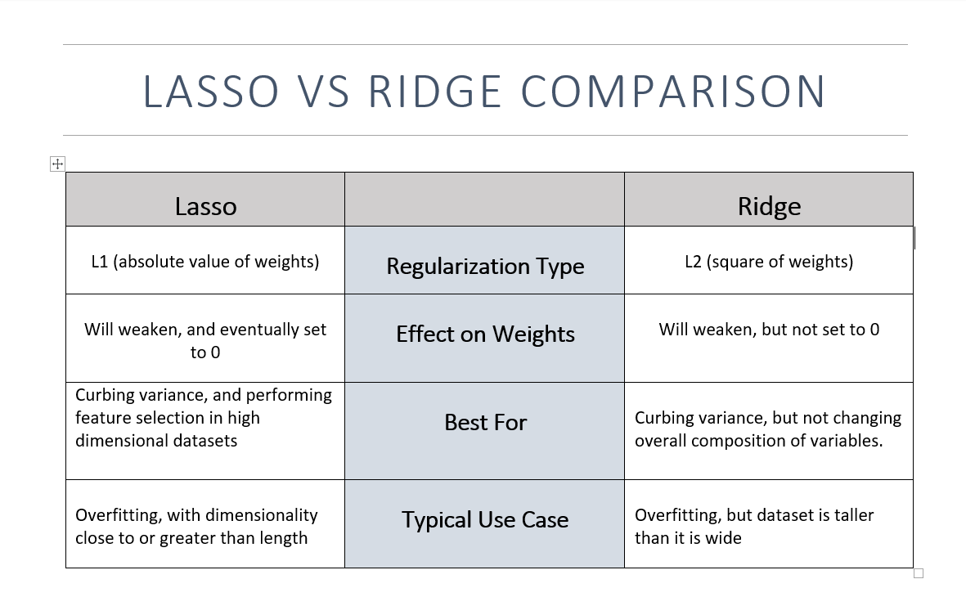
Notes:
After this slide, introduce Ridge Regression, point out alpha as a parameter, and make the chart -- decide for yourself if it’s a good idea to do it by hand or not.

